Slide 1
MongoDB for Developers
Module 04 - Indexers

Slide 2
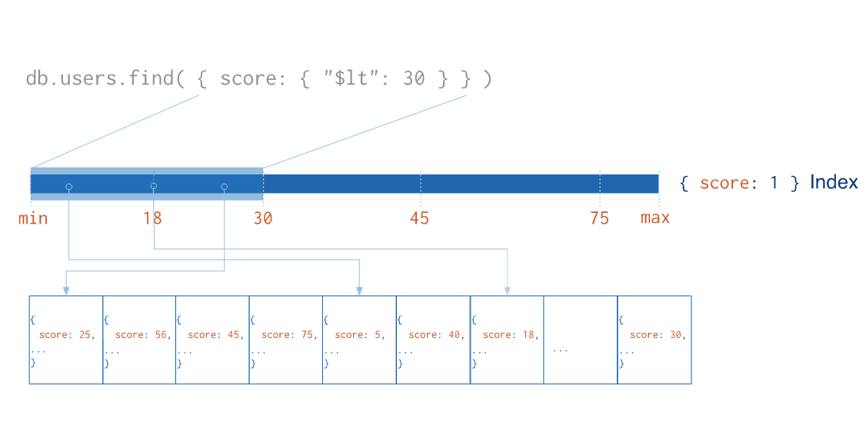
MongoDB Indexes
Notes:
Single field index illustration in MongoDB
Saved in disk
Q1: What are the cont. of indexes?

Slide 3
MongoDB Indexes - Introduction
Support efficient execution of queries, by eliminating collection scan, which scan every document in the collection
Instead of collection scan , Mongo can use the index to significant limit the number of documents it must examine
Are similar to other to indexes in other databases (B-Tree)
Indexes make the reads faster at the expense of slower writes
Notes:
It stores the values of one or more fields, ordered by descending or ascending(configured by the user)
This ordering supports efficient traverse for equality and range based queries. In Addition, sorted queries can be performed on the index, eliminate the need to sort the whole result-set
Q2: When we need to insert a lot of data, what approach is better? Create the index first, and than insert the data? Or maybe the opposite?

Slide 4
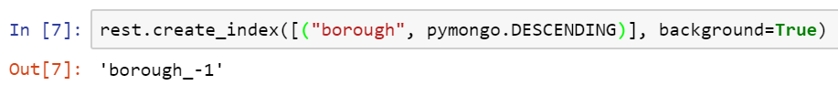
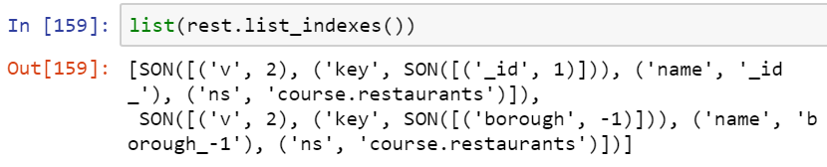
MongoDB Manage Indexes
Python
Mongo Shell
Create index:
List all indexes:
Drop index:
Notes:
Some common options:
background(boolean) – the index should be created in the background. Use this option when the collection stores a lot of data, and the app need to be able to access it, while building the index
name – the name of the index. If not set, a custom name generated
unique(boolean) – create a unique constraint on the index
SON – a BSON type for ordered data structure, because python dictionary isn’t ordered

Slide 5
MongoDB Index Types
Single field – index on a single field of the document.
For example, mongo creates a unique single field index on the _id field, at the process of collection creation
Compound index – one index on multiple fields of the document
Multikey index – index for array fields. It creates an index key for every element in the array
Notes:
Single field index – for sort operation the ordering of the index is not relevant, because mongo can traverse it in either direction
_id field – acts as primary key for each collection. If the user omits the _id field while inserting a doc, the Driver will create it for him.
The default type of the _id called ObjectId(small, fast to generate, likely-unique and ordered)
You can choose any BSON type except array, it must be unique inside the collection, and it automatically indexed
Compound index – the syntax is the same as single field, except that you can add more fields(up to 31)
sort is matter. E.g. an index key pattern {x: 1, y: 1} cannot support sort on {y: 1, x: 1}
Multikey index – mongo automatically creates a multikey index when you will specify an array field
Index Types – There are more types:
Text – for text search queries on string content
2dsphere – for geospatial queries(inclusion, intersection and proximity)

Slide 6
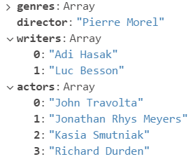
MongoDB Index Types - Examples
Compound index:
Multikey index:
For the given doc, we can create multikey compound
Index, on the fields:
(writers)
even for (director, writers)
but not for the fields (writers, actors)
Index definition: (name, age, gender)
Search for | Use the index
name | V
name, age | V
name, age, gender | V
gender | X
age, gender | X
name, gender | Partial V
Notes:
Partial V – it will the index for the name, and through all of them for the gender index
Multikey example:
First example - the index will contains all the array values of the writers docs(in the specified order) in this collection
Second example – the index will contains all the pairs of the director field with the array value in the specified order, e.g: [("Pierre Morel“, "Adi Hasak“), ("Pierre Morel“, “Luc Besson“)]
Third example – the reason why it will raise an exception("CannotIndexParallelArrays") is that otherwise, Mongo need to create the cartesian product of the array values and that heavy operation

Slide 7
MongoDB Index Properties
TTL indexes – MongoDB automatically remove docs from the collection after a certain amount of time or at specific clock time
A doc will expire when the number of seconds in the expireAfterSeconds field has passed since the time specified in its indexed field
Works only on the date datatype
For example:
db.app_log.createIndex( { “created": 1 }, { expireAfterSeconds: 3600 } )
Inserted Doc: {created: new Date(), message: “Succeeded”}
Notes:
TTL indexes – managed by a separate mongo thread that runs in the background, and delete the expired docs each 1 minute
If the field is an array of dates, it will use the earliest(lowest) value in the array
For specific clock time expiration, just put expireAfterSeconds: 0 , and in the date filed put the expired datetime you want
Supports only on the single field index

Slide 8
MongoDB Index Properties
Unique index – ensures that the indexed fields do not store duplicate values (pass { unique: true })
Partial index – index only the docs that meet a specified filter expression.
Lower storage requirements
Reduced performance costs for maintenance and index creation
Notes:
Unique index :
The _id field has a unique index by default
For compound and multikey indexes, the unique will preserve for the combination of the index key values
If the field does not exist in the doc when inserted, the unique index will generate null value for the key. Mongo will permit only one doc that lacks the indexed field
Partial index:
Allowed operators: $eq, $exists, $gt, $gte, $lt, $lte, $type, $and(top level only)
More efficient – the operations of create index and rebuild index, will be less heavy, because the storage requirement is lower

Slide 9
MongoDB Index Properties
partial index example:
Some notes:
Mongo will use the index only for queries that contain the filter expression, or a modified filter that specifies a subset of the original filter
For example, for a query on borough field, and rating greater than 8, it will use the index, while the same query with rating lower than 5, it won’t use the index
Notes:
Partial index – the first query can use the index because rating greater than 8 matches a subset of docs matched by the index filter(greater than 3),
While the second query matches more docs than are indexed(for example, rating equal to 1), thus cannot use the index

